Slide 1


EMPLOYEE ATTRITION
By – Pragathi B Shetty

Slide 2

PROBLEM STATEMENT:
XYZ company which was established a few years back is facing around a 15% attrition rate for a couple of years. And it's majorly affecting the company in many aspects. In order to understand why employees are leaving the company and reduce the attrition rate XYZ company has approached an HR analytics consultancy for analyzing the data they have. You are playing the HR analyst role in this project and building a dashboard which can help the organization in making data-driven decisions.
Tool Used
Microsoft Excel
Microsoft Power BI

Slide 3
DATASET OVERVIEW
Here are some data that I modified for my analysis:
Employee ID
Age
Attrition
Department
Education
Education Field
Employee Count
Gender
Job Level
Job Role
Marital Status
Monthly Income
Percent Salary Hike
Year At Company
Job Satisfaction

Slide 4

Key words
MY OBSEVATION :
Initial Data := A Salary hike of 25% was implemented, resulting in an attrition count of 3 employees.
Updated Data := The salary hike decreased to 13%, leading to an increased in attrition to 36 employees.
Final Data := Further reduction in the salary hike to 11% resulted in 18 employees leaving the company.
The initial 25% salary hike corresponded with low attrition rates, suggesting a positive impact on employee retention. A reduction in the salary hike to 13% saw a significant rise in attrition, with 36 employee leaving indicates attrition rates to lower salary hikes. Despite a slight decrease in the salary hike to 11%, attrition decreased to 18 employees, but remained higher than the initial data.
Conclusion :
There is a notable impact of salary hike adjustments on employee turnover, underscoring the importance of strategic compensation planning in that talent retention strategies.
------------------- | ---------------
Total Employee | 4410
Attrition | 711
Percentage | 16%
Average Year in Company | 7.01

Slide 5
SINGLE |  | MARRIED |  | DIVORCED
Total Employee | 552 | Total Employee | 846 | Total Employee | 366
Attrition | 129 | Attrition | 108 | Attrition | 33
Percentage | 23% | Percentage | 13% | Percentage | 9%
Average Age | 36.26 | Average Age | 38.33 | Average Age | 36.79
Average Year in Company | 6.37 | Average Year in Company | 7.43 | Average Year in Company | 7.63
FEMALE

Slide 6
SINGLE |  | MARRIED |  | DIVORCED
Total Employee | 858 | Total Employee | 1173 | Total Employee | 615
Attrition | 231 | Attrition | 144 | Attrition | 66
Percentage | 27% | Percentage | 12% | Percentage | 11%
Average Age | 34.74 | Average Age | 37.34 | Average Age | 37.91
Average Year in Company | 6.38 | Average Year in Company | 7.22 | Average Year in Company | 7.11
MALE

Slide 7


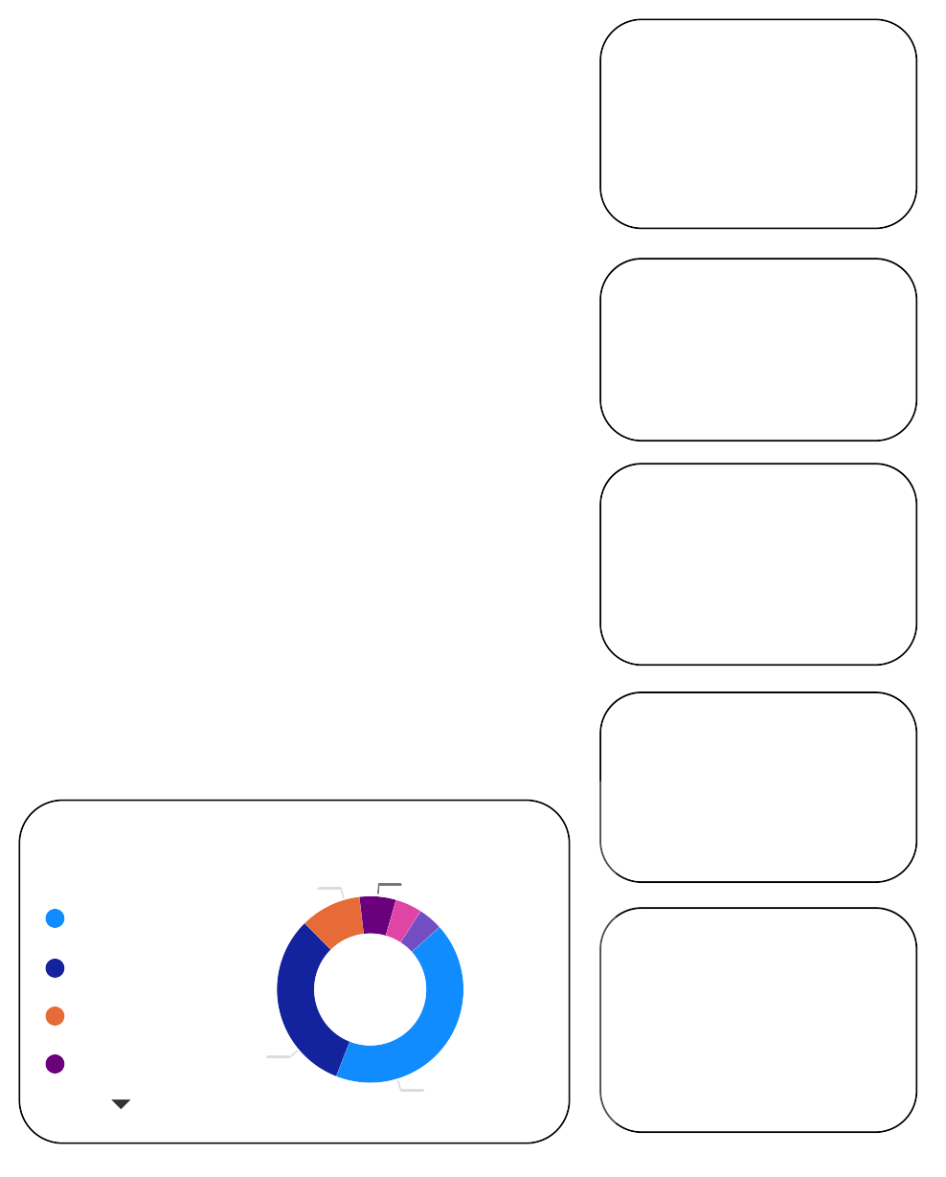





EMPLOYEE ATTRITION DASHBOARD
Power BI Desktop
All 
MaritalStatus
Divorced
Married
Single

Female
1000
4410
711
16%
36.92
7.01
Attrition
100
Male
10
Sales Executive
Research Scientist
Labora… Health… Research Technic… Repres… Director
Job Role
Manuf… Manager Sales Director Repres…
Human Resour…
JobRole | 1 | 2 | 3 | 4 | NA | Total
Healthcare Representative | 84 | 66 | 114 | 126 | 3 | 393
Human Resources | 24 | 18 | 47 | 66 | 1 | 156
Laboratory Technician | 158 | 147 | 246 | 224 | 2 | 777
Manager | 59 | 54 | 99 | 93 | 1 | 306
Manufacturing Director | 72 | 87 | 133 | 139 | 4 | 435
Research Director | 32 | 51 | 75 | 81 | 1 | 240
Research Scientist | 176 | 189 | 252 | 256 | 3 | 876
Sales Executive | 186 | 198 | 285 | 305 | 4 | 978
Sales Representative | 69 | 30 | 72 | 77 | 1 | 249
Total | 860 | 840 | 1323 | 1367 | 20 | 4410
200
Attrition
100
0
0
2
4
6
8
10
12
14
Sum of Age
10
Education…
Life Sci…
Medical Marketi… Technic…
75.00
(10.55%)
45.00 (6.3…)
50
Attrition
Salary
0.43K
8.19K
20
0
0
225.00 (31.…)
50
0
100
303.00
(42.62%)

Slide 8
THANK YOU

